Slide 1
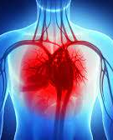
Predicting Heart Failure
by Gabe Ali, Hossein Alamatsaz, Omer Osman

Slide 2
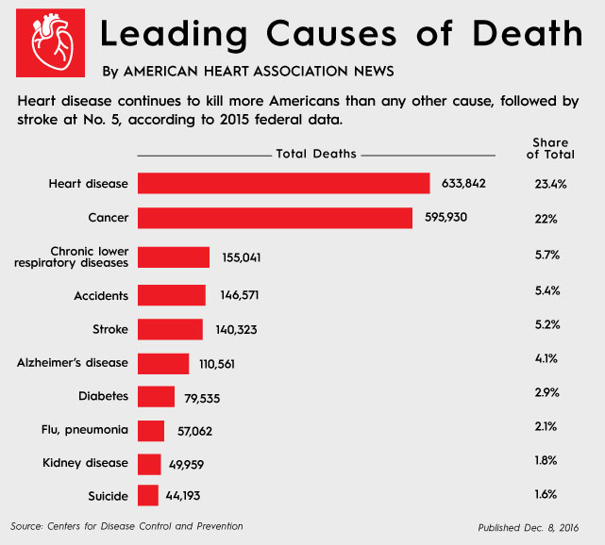
BACKGROUND INFORMATION
Cardiovascular diseases are classified by the World Health Organization as the #1 cause of death
Where more people have died annually from CVDs than from any other cause
With an estimated number of 17.9 million people dying from CVDs in 2016
CVDs are a group of disorders of the heart and blood vessels, from which Heart Failure is included in
https://www.heart.org/en/news/2018/05/01/heart-disease-stroke-death-rates-increase-following-decades-of-progress
Notes:
https://www.who.int/news-room/fact-sheets/detail/cardiovascular-diseases-(cvds)

Slide 3
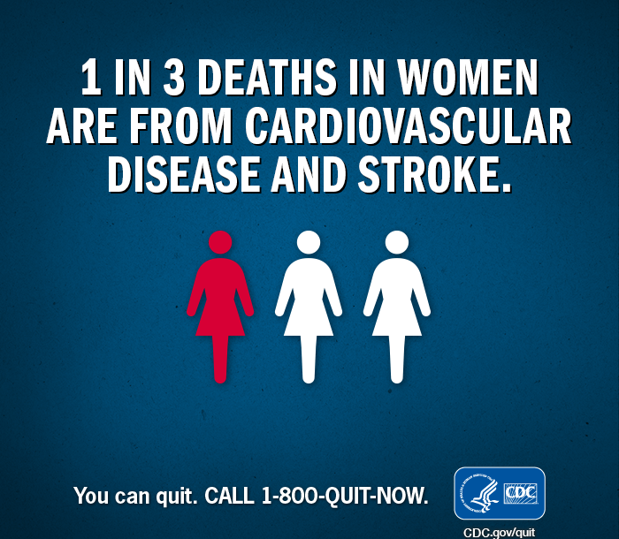
SO WHY HEART FAILURE?
When people think of CVDs, they think of Heart Attacks and Strokes
The cause of heart attacks, strokes, and CVDs in general is due to the presence of a combination of risk factors
The reason we wanted to explore the topic of heart failure is because we wanted to determine how these risk factors play into the incidence of patients developing CVDs and to predict a death event from Heart Failure
With the purpose of using our model to help build an effective disease management strategy
Notes:
https://www.freepik.com/premium-vector/cute-funny-smiling-doctor-cardiologist-healthy-happy-heart-healthcare_7068028.htm

Slide 4
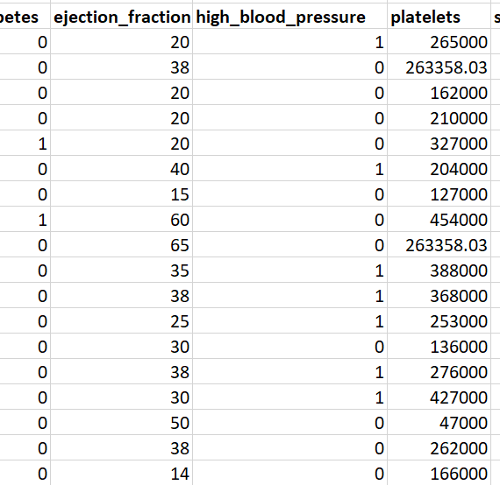
Dataset
We obtained our data from the dataset publishing site Kaggle.com
It consists of 300 rows and 13 columns which pertain to the clinical risk factors that influence the rate of mortality caused by Heart Failure
Notes:
Risk Factors include:
Age of patient
Anaemia percentage
Level of Creatinine Phosphoinase enzyme
If patient has Diabetes (Yes/No)
Ejection fraction
If patient has High Blood pressure,
Level of platelets in patient’s blood
Level of Serum Creatinine
Level of Serum Sodium
Sex/Gender
Time since last follow-up
If patient smokes or not
Death event

Slide 5
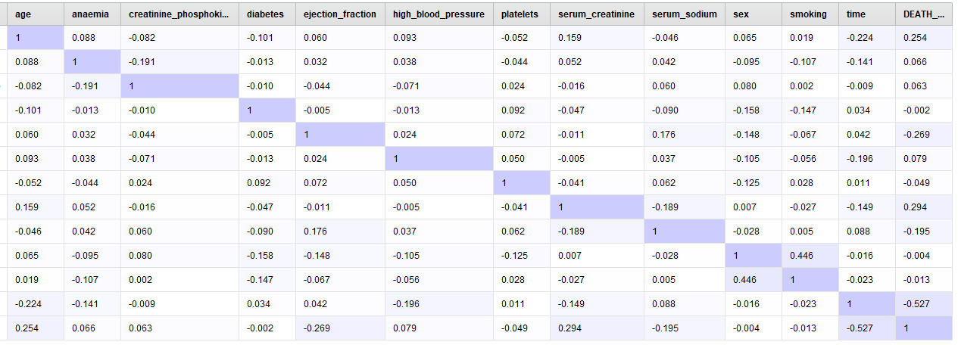
Correlation Matrix

Slide 6
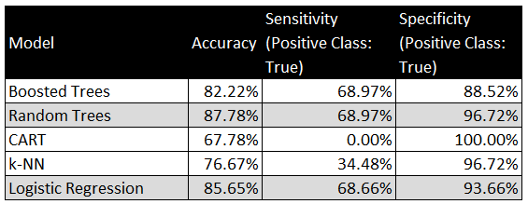
Evaluations
Highest Accuracy
Random Trees
Logistics Regression
Sensitivity/Specificity
Relatively high compared to other models
Notes:
Highest Accuracy
Random Trees
Logistics Regression
Sensitivity/Specificity
Relatively high compared to other models

Slide 7
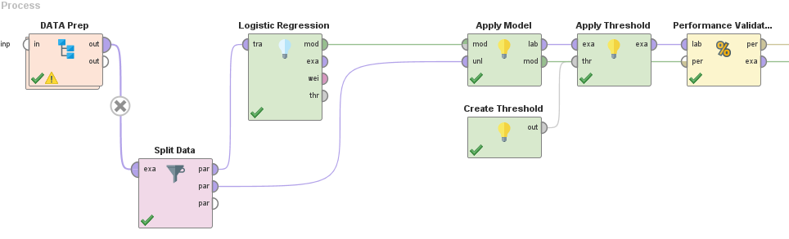
Algorithm 1: Logistics Regression
Notes:
We chose the Logistic Regression as our first algorithm because of its robust nature
As it enables us to correctly

Slide 8
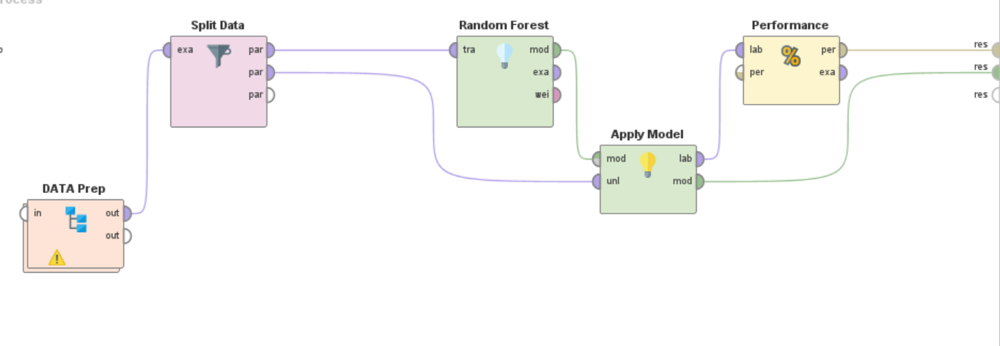
Algorithm 2: Random Trees

Slide 9
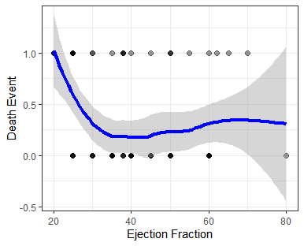
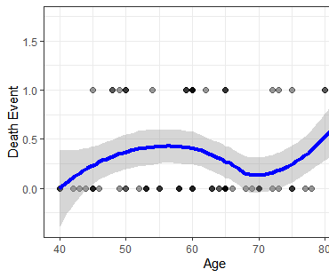
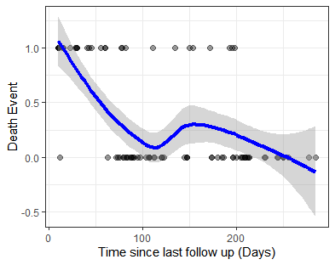
Findings & Insights
We found 3 major significant Predictors of Heart Failure
Age
Ejection fractions
Time since patient’s last doctor visit
Notes:
So reflecting upon our RapidMiner output, the most profound insight that we obtained was that there were 3 major significant predictor heart failure that kept appearing
Which include:
Age of the patient
The Ejection Fractions which is the Percentage of blood leaving the heart at each contraction (percentage)
And finally time passed since the patient’s last doctor visit concerning existing Cardiovascular problems, where frequent visits aren’t a good thing
If you look to the left in the first graph, you can see that the lower a patient’s ejection fraction is more likely they will pass from Heart Failure
In the middle graph, interestingly enough, it shows that as one ages the odds the go up and then drop around before age 70 weirdly enough, then pick up again
In the last graph, if a patient frequently visits their cardiovascular doctors or a shorter time has passed since their last visit they are more likely to die

Slide 10

Challenges & Limitations
One challenge we had in our models was variable selection
Transparency issues with one of the models
Limitation in dataset variable classification
Notes:
So some of the challenges and limitations of our models included
Reducing the number of trees returned by the output, might’ve made the model stronger accuracy wise.
One challenge we had in our models was variable selection
By utilizing forward or backward selection, we may potentially have a more concise algorithm or more accuracy
Transparency issues with one of the models
Individual regression trees pose no issue with transparency
However, random forest trees, when fully ensembled become hard to interpret with the different number of trees that are produced as output
Limitation in dataset variable classification
Column in table called “Time” which measures time since last follow-up with doctor
Not very clear, it doesn’t explicitly differentiate if its regular doctor visits or CVD consultations

Slide 11

Recommendations
More attributes the better
Though our dataset includes 12 sufficcient attributes, allowing more predictors (such as cardiac symptoms, hypertension, etc.) leads to a more accurate model
Broader age range
Our dataset includes individuals aging 40+, rise in obesity and diabetes adds heart failure risks
Use aggregate measures for certain predictors for more clarity
More insightful models (rather than 0/1, build model actual measures of attributes)
Integral data for some attributes (Blood Pressure, Diabetes [blood sugar], Anaemia [red blood cells], etc.) allows for analysis of severity of condition
Notes:
For those that are looking to employ a similar model, we recommend that:
They include more attributes,
like certain behaviors, like do they excersise
They include a broader age
As more young people are suffering from obesity, diabetes, other ailments that add to heart failure risks
Use aggregate measures for certain predictors for more clarity
Using raw data for the existing predictors instead binary yes/no data would help the model greatly
For example using measuring the Blood sugar by units milligrams per deciliter

Slide 12

THANK YOU FOR LISTENING

Slide 13
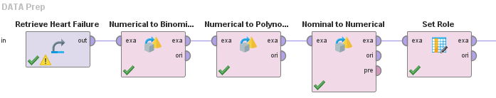
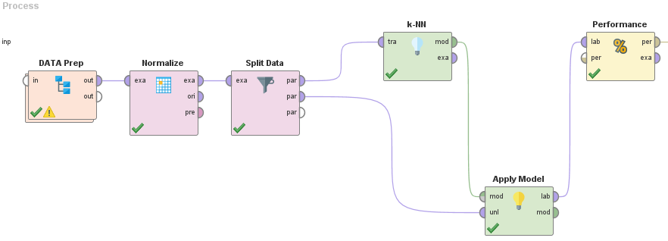
APPENDIX A: k-NN Process

Slide 14
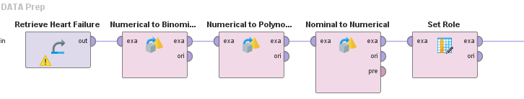
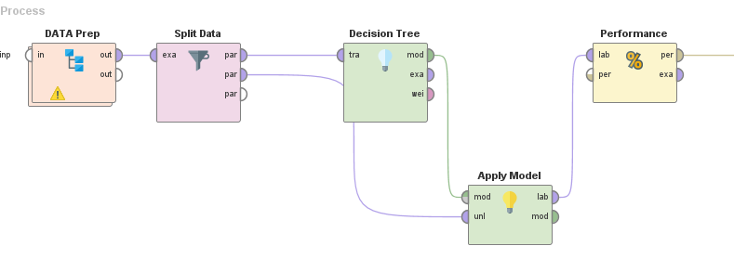
APPENDIX B: CART Process

Slide 15
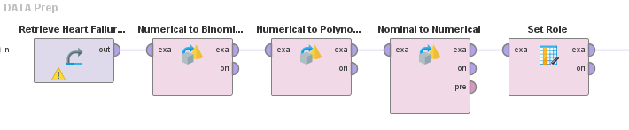
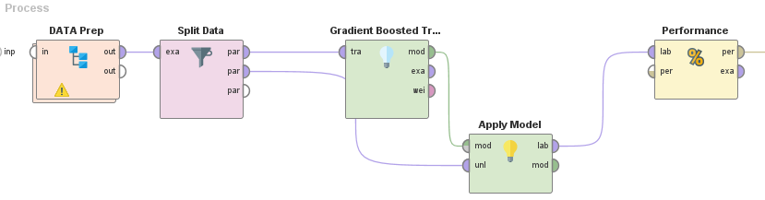
APPENDIX C: Trees Process

